Slide 1
SQL

Slide 2
Announcements
One week left – main task: Ants project
This week: SQL + AMA "Lecture"
Next Week: RRR week –
NO CLASS, modified OH schedules
Monday Zoom Review/Wrap Up Session

Slide 3

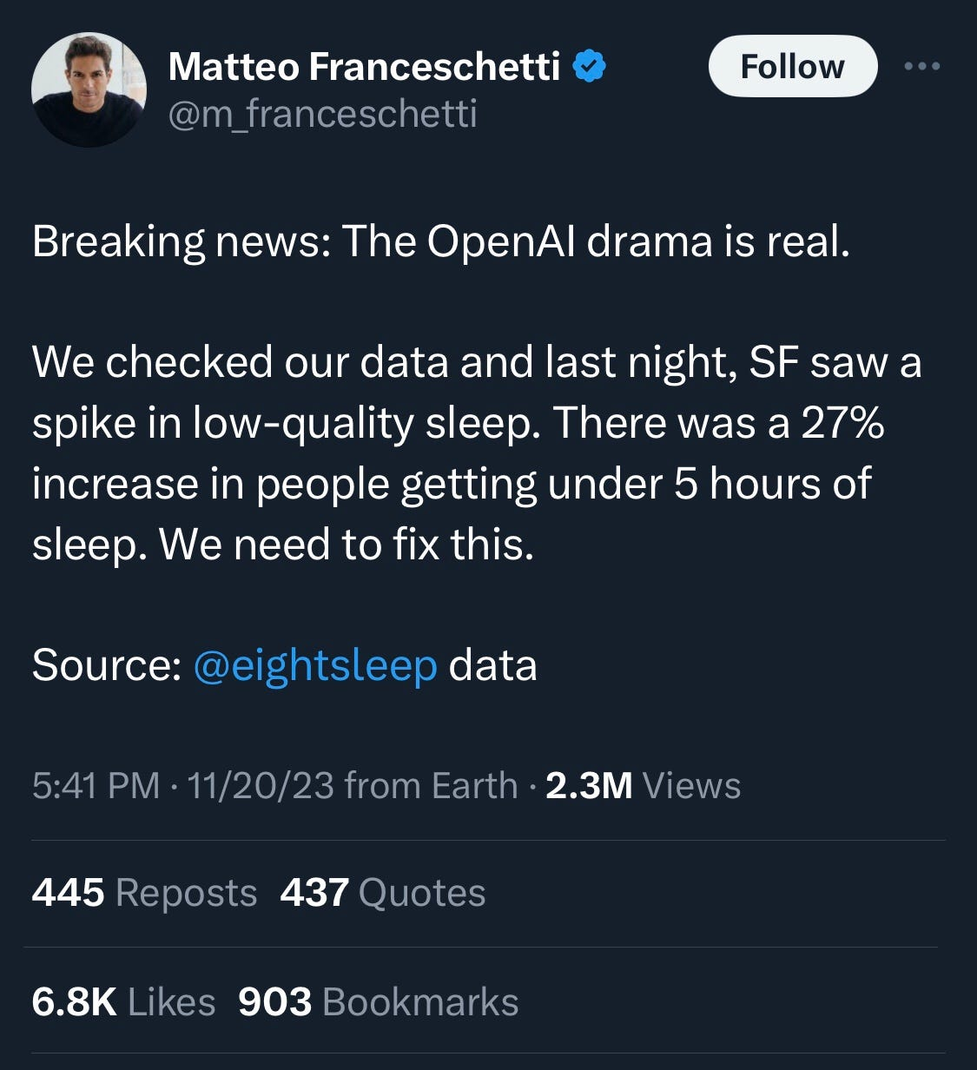
Open AI Drama [Wired]
STEVEN LEVY NOV 22, 2023 11:24 AM
OpenAI’s Boardroom Drama Could Mess Up Your Future
OpenAI’s board ejected Sam Altman in an apparent attempt to preserve the company mission of keeping AI development safe. The ensuing drama, even after Altman’s return, did not inspire confidence.
In June I had a conversation with chief scientist Ilya Sutskever at OpenAI’s headquarters, as I reported WIRED’s October cover story. Among the topics we discussed was the unusual structure of the company.
----
Aside: Funny / Terrible Notes about data privacy…
Sam Altman with large red light leak overlay SEONGJOON CHO/GETTY IMAGES

Slide 4
SQL Basics
SQL Keywords are case-insensitive
e.g. SELECT and select do the same thing
I try to capitalize them to make it clear what's-what.
The order of SQL keywords matters
e.g. SELECT ... FROM … WHERE …
Every statement ends in a ;
Whitespace doesn't matter
But indentations and newlines help make queries readable!
Despite being a standard, differences do exist between databases. We use sqlite3.

Slide 5
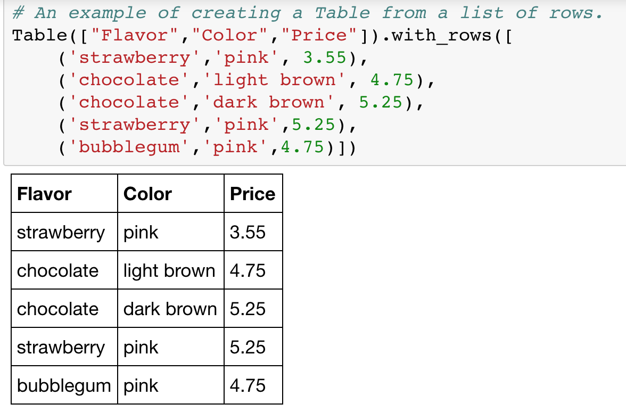

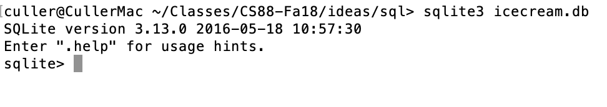
A Running example from Data 8

Slide 6
SELECT
Comma-separated list of column descriptions
Column description is an expression, optionally followed by as and a column name
Selecting literals creates a one-row table
union of select statements is a table containing the union of the rows
select [expression] as [name], [expression] as [name]; . . .
select "strawberry" as Flavor, "pink" as Color, 3.55 as Price;
select "strawberry" as Flavor, "pink" as Color, 3.55 as Price union
select "chocolate","light brown", 4.75 union
select "chocolate","dark brown", 5.25 union
select "strawberry","pink",5.25 union
select "bubblegum","pink",4.75;

Slide 7
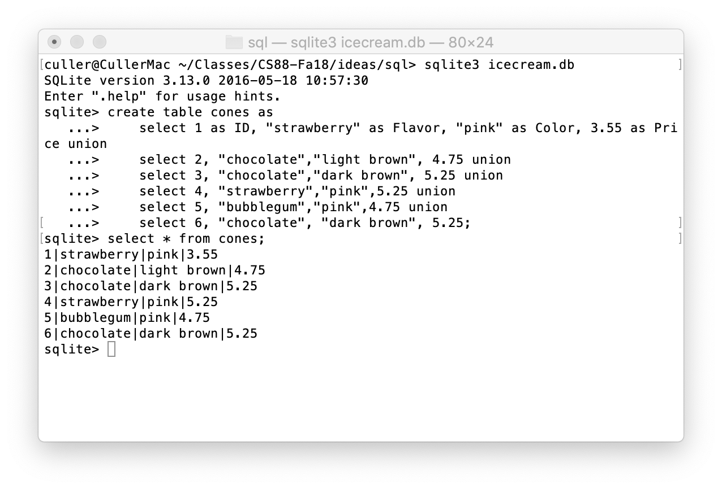
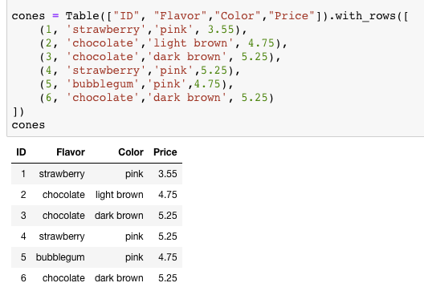
SELECT …

Slide 8
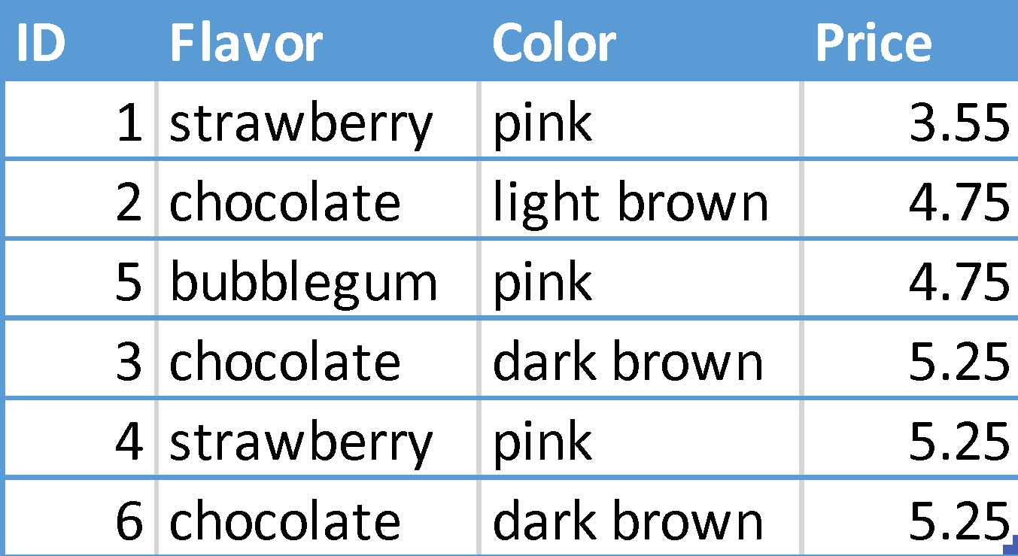
Projecting existing tables
Input table specified by from clause
Subset of rows selected using a where clause
Ordering of the selected rows declared using an order by clause
select [columns] from [table] where [condition] order by [order] ;
SELECT * FROM cones ORDER BY Price;

Slide 9
What's different about this table? IDs!
In practice, every row or record in a table should have a unique unambiguous ID
Why?
How do we know if a record is the same as some other value?
A properly setup table will handle this for you. ☺
We'll see it's use in next lecture.

Slide 10
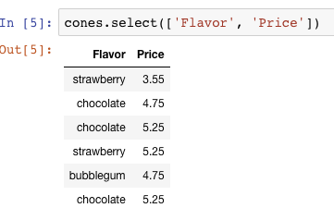
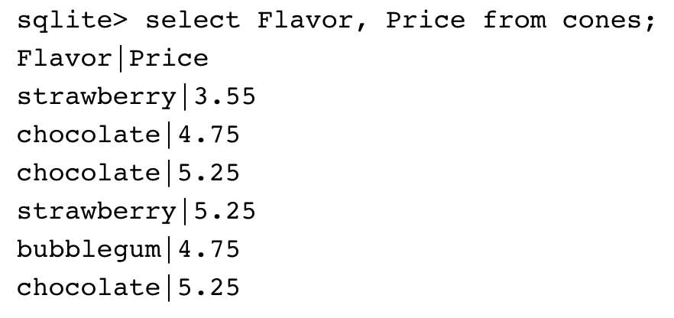
Projection
A “projection” is a view of a table, it doesn’t alter the state of the table.

Slide 11
Filtering in SQL

Slide 12
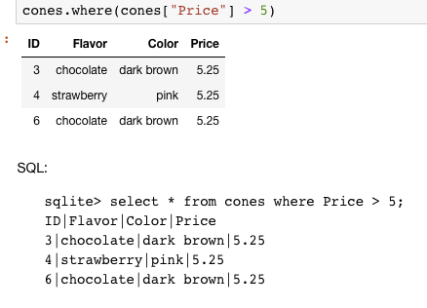
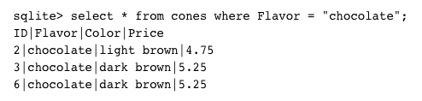
Filtering rows - where
Set of Table records (rows) that satisfy a condition
select [columns] from [table] where [condition] order by [order] ;

Slide 13
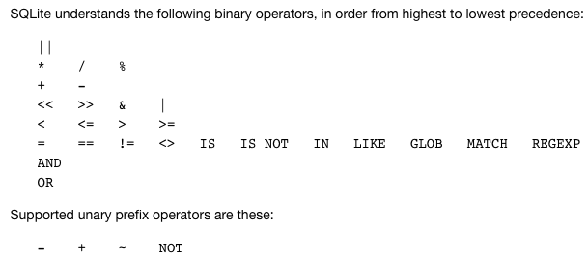
SQL Operators for predicate
use the WHERE clause in the SQL statements such as SELECT, UPDATE and DELETE to filter rows that do not meet a specified condition

Slide 14
Approximate Matching: LIKE [Docs]
LIKE compares text to a pattern
Case-Insensitive by default. Means 'a' and 'A' are the same.
Allows "wildcards" that match any character.
% means "zero or more" characters at this "spot" in the pattern
Examples:
'abc' LIKE 'abc' → true
'abc' LIKE 'a%' → true
'abc' LIKE '%b%' → true –shortcut for "does abc contain b?"
'b' LIKE '%b%' → true
'abc' LIKE 'c' → false

Slide 15
Summary
SQL a declarative programming language on relational tables
largely familiar to you from data8
create, select, where, order, group by, join
Databases are accessed through Applications
e.g., all modern web apps have Database backend
Queries are issued through API
Be careful about app corrupting the database
Data analytics tend to draw database into memory and operate on it as a data structure
e.g., Tables

Slide 16
Summary – Part 1
SELECT <col spec> FROM <table spec> WHERE <cond spec>
GROUP BY <group spec> ORDER BY <order spec> ;
INSERT INTO table(column1, column2,...)
VALUES (value1, value2,...);
CREATE TABLE name ( <columns> ) ;
CREATE TABLE name AS <select statement> ;
DROP TABLE name ;

Slide 17
SQL: Aggregations

Slide 18
Aggregations are Powerful & Common!
SELECT date_trunc('day', created) as date, COUNT(*)
FROM users
WHERE created > current_date - interval '1 year'
GROUP BY date;
date | count
Apr 17, 2023, 12:00 AM | 136
Apr 18, 2023, 12:00 AM | 257
Apr 19, 2023, 12:00 AM | 326
Apr 20, 2023, 12:00 AM | 167
Apr 21, 2023, 12:00 AM | 144

Slide 19
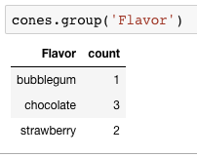
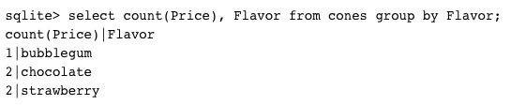
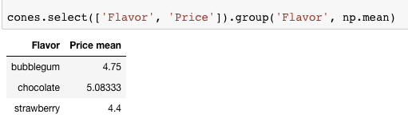
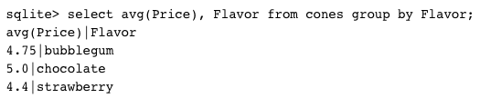
Grouping and Aggregations
The GROUP BY clause is used to group rows returned by SELECT statement into a set of summary rows or groups based on values of columns or expressions.
Apply an aggregate function, such as SUM, AVG, MIN, MAX or COUNT, to each group to output the summary information.

Slide 20
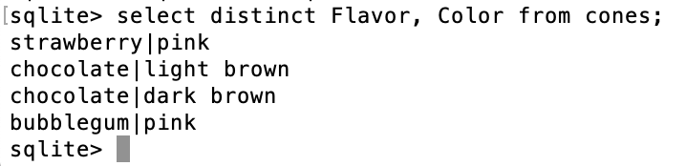
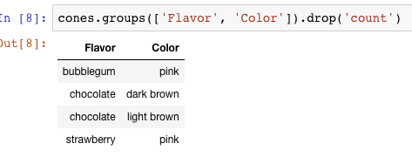
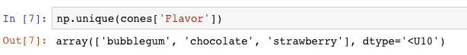
Unique & DISTINCT values
select DISTINCT [columns] from [table] where [condition] order by [order] ;

Slide 21
SQL: Joins

Slide 22
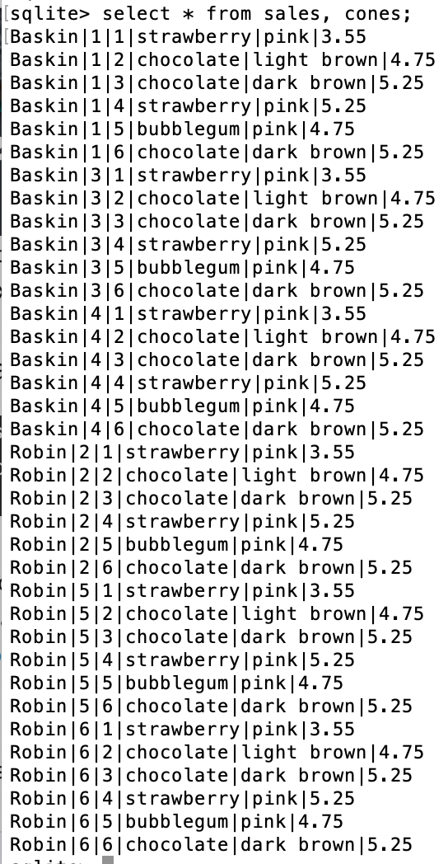
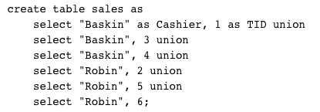
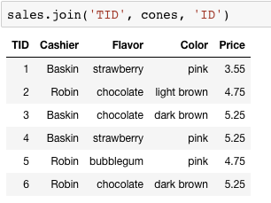
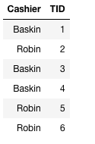
Joining tables
Two tables are joined by a comma to yield all combinations of a row from each
select * from sales, cones;

Slide 23
Joins
Joins combine two tables
A "cross product" or full join gives all combiniations
This is often not useful!
So, we can do an inner join where we "combine" rows only on some logical identifier, like an "id"
Often this is called a "foreign key" or a reference to an object in another table.

Slide 24
Inner Join
SELECT * FROM sales, cones WHERE cone_id =cones.id;
When column names conflict we write: table_name.column_name in a query.
sqlite> SELECT * FROM cones, sales WHERE cone_id=cones.id;
Id|Flavor|Color|Price|Cashier|id|cone_id
1|strawberry|pink|3.55|Baskin|3|1
1|strawberry|pink|3.55|Robin|6|1
2|chocolate|light brown|4.75|Baskin|1|2
2|chocolate|light brown|4.75|Baskin|4|2
2|chocolate|light brown|4.75|Robin|5|2
3|chocolate|dark brown|5.25|Robin|2|3

Slide 25
Putting It All Together:
Which of our cashiers sold the highest value of ice cream?
First we need to find which cones were sold by whom, then we SUM() the results!
sqlite> SELECT Cashier, SUM(Price) as 'Total Sold' FROM sales, cones WHERE sales.cone_id = cones.id GROUP BY Cashier;
Cashier|Total Sold
Baskin|13.3
Robin|13.8

Slide 26
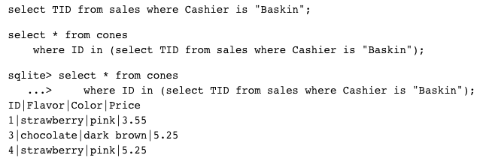
Queries within queries
Any place that a table is named within a select statement, a table could be computed
As a sub-query

Slide 27
SQL: CREATE and INSERT and UPDATE
(THIS IS NOT TESTED IN 88C!)

Slide 28
CREATE TABLE
SQL often used interactively
Result of select displayed to the user, but not stored
Can create a table in many ways
Often may just supply a list of columns without data.
Create table statement gives the result a name
Like a variable, but for a permanent object
CREATE TABLE [name] AS [select statement];

Slide 29
SQL: creating a named table
CREATE TABLE cones AS
select 1 as ID, "strawberry" as Flavor, "pink" as Color, 3.55 as Price union
select 2, "chocolate", "light brown", 4.75 union
select 3, "chocolate", "dark brown", 5.25 union
select 4, "strawberry", "pink",5.25 union
select 5, "bubblegum", "pink",4.75 union
select 6, "chocolate", "dark brown", 5.25;
Notice how column names are introduced and implicit later on.

Slide 30
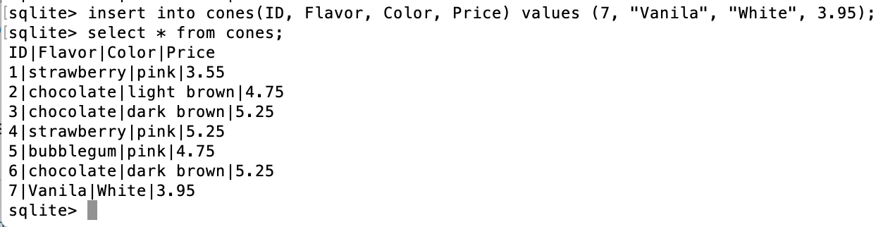
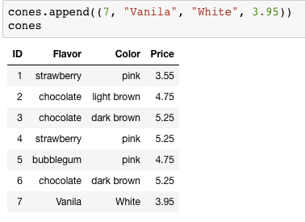
Inserting new records (rows)
A database table is typically a shared, durable repository shared by multiple applications
INSERT INTO table(column1, column2,...)
VALUES (value1, value2,...);

Slide 31
UPDATING new records (rows)
If you don’t specify a WHERE, you’ll update all rows!
UPDATE table SET column1 = value1, column2 = value2 [WHERE condition];

Slide 32
Summary
SELECT <col spec> FROM <table spec> WHERE <cond spec>
GROUP BY <group spec> ORDER BY <order spec> ;
INSERT INTO table(column1, column2,...)
VALUES (value1, value2,...);
CREATE TABLE name ( <columns> ) ;
CREATE TABLE name AS <select statement> ;

